Slide 1
Reservoir Computing: Topological Choices, Sliding Thresholds, and STDP Learning Variants
CS colloquium
06/06/2012
ט״ז בסיון תשע״ב
Hananel Hazan , Larry Manevitz
Department of Computer Science, University of Haifa, Mount Carmel, Haifa 31905, Israel
[hhazan01 , manevitz]@cs.haifa.ac.il.

Slide 2
Outline of the Talk
traditional technique
Give an input to the framework wait a while then identify
What is a Reservoir Computing and Liquid State Machine Framework?
Traditional technique
What is missing?
Feed the input and identify on the fly
How To Test?!
LSM
Tests
Categories
Function Approximation
Wait & ID
ID On The Fly
fMRI BOLD activity
Biological improvements
Biological improvements

Slide 3
Traditional Neuron Networks
Perceptron, Adaline →
  can classify linearly separable data (Yes/No)
  can approximate every linear function.
Multi Layer Perceptron, Feed-Forward Network→
  can classify linear and non-linearly separable data.
  can be used as a universal approximation for every continuous mapping of the form f(X)→Y where X and Y are bounded real-valued sets.
The main problem is time ☺
  Feature extraction from Voice, Music, Video
  Function Fitting (EEG , BOLD hemodynamics, etc.)
  What happen when the signal function involves time? Convert time to space?
Result:
Networks grow exponentially in relation to time.

Slide 4
What Can Liquid / Reservoir Add To The Normal Machine Learning Techniques?
{A}
{
B}
{
C}
{
D}
Stimulus
Time
The Liquid / Reservoir Framework can encode the signal with time and represent both of them in the “standard spatial” way, that lets a traditional detector “know” at any time
  what is the time
  what stimuli were entered
  when the specific feature was given!
How does it do that?

Slide 5
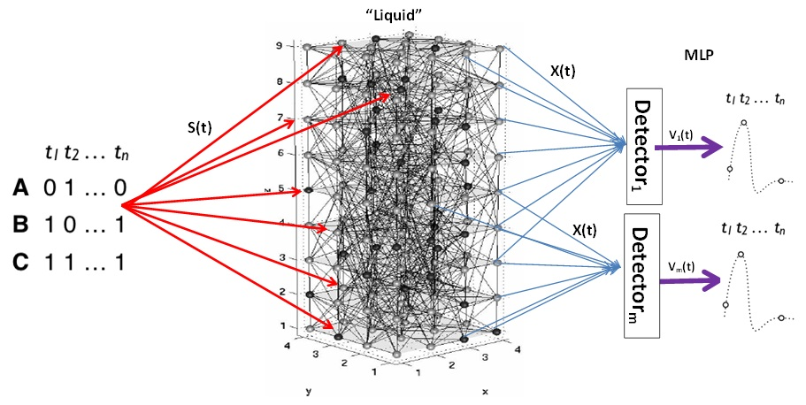
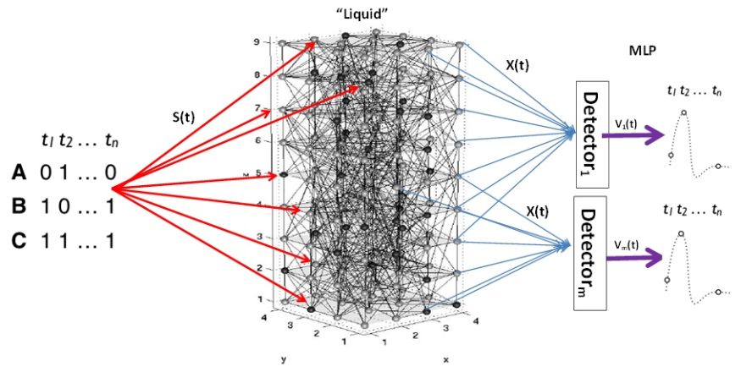
What is a Liquid State Machine?
Some of the nodes receive input from external sources in addition to input from other nodes.
The recurrent nature of the connections turns the time varying input into a spatio-temporal pattern of activations in the network nodes.
The spatio-temporal patterns of activation are read out by linear discriminate units.

Slide 6
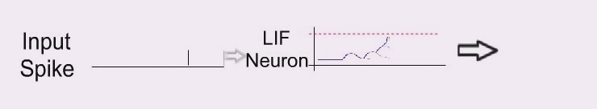
Liquid Technical Specification
243 Units
20% Inhibitory 80% Excitory
Unit = Leaky Integrate and Fire neuron (LIF).
External Input = 30%
Connectivity between neurons = 20%
Delay = 1 interval
Weight = 0.5~0.55
Spike = 80mV
Threshold = 30mV
Reset Level = -65mV
Asynchrony
OR
Synchrony Update

Slide 7
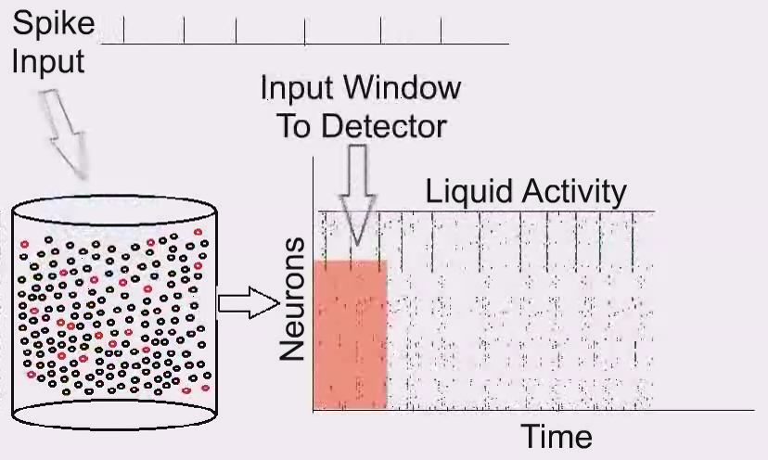
How Does a Liquid State Machine Framework work?
The state of the liquid capture information in time

Slide 8
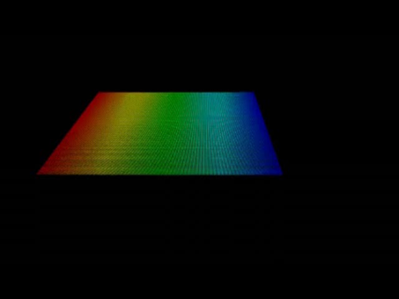
Demo, Sliding window of information
Which representation matches its music?
t
m
f
1
f
2
3
y → magnitude
x → time
z → frequency

Slide 9
Possible Tests
Tests
Categories
Function Approximation
Classify signals

Slide 10
How We Test The Framework
Categories
2
1
Wait & ID
ID On The Fly
There is at list two ways to test the capabilities of the Liquid State Machine
Continuous input and Detection on the fly.
Give an Input, wait a while then Detect what was the input.
Categories

Slide 11
Maass’s et al General Test Setup
LSM learns 20 Temporal Patterns of 0/1 length of 80-bits as two groups A and B.
  Verify that the LSM knows the testing set.
  Input Generalization :
  Use random noise in the input string to the LSM and not in the Liquid it self.

Slide 12
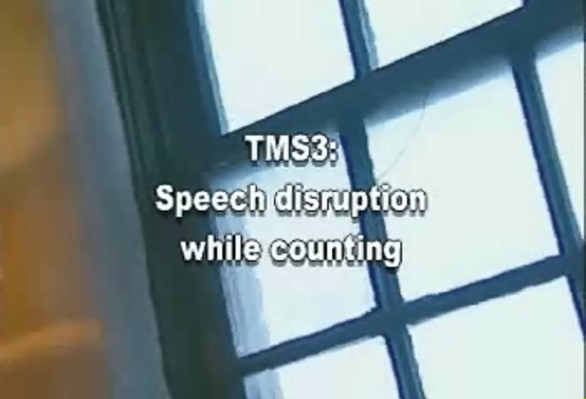
Liquid State Machine Framework
Maass et al make sure that the LSM is resilient to Input changes (Generalization)
BUT
One of the key feature of biological model is robustness
We know that biological parts are not like electronic parts:
  There is no clear specs of the biological parts.
  Lots of room for random behavior.
  Can be resilient to damage.

Slide 13
Our Test Setup
LSM learns 20 Temporal Patterns of 0/1 length of 80-bits as two groups A and B.
  LSM Robustness :
  Use random noise inside the Liquid and try to recognize the sets, by choosing X% of random neurons:
      Force the neuron to emit spike regardless of its situation.
      Force the neuron to omit spike and ignore everything regardless of its situation.
      Force the neuron to emit spike OR to ignore everything regardless on its situation.

Slide 14
Maass et al Architectures
Damage in the Input
Damage in the Liquid
Damage in the Liquid
Damage in the Liquid

Slide 15
Maass et al Architectures
Topologies
Noise Generator
Dead Neurons
Failed
Generalization Test
Combine Test

Slide 16
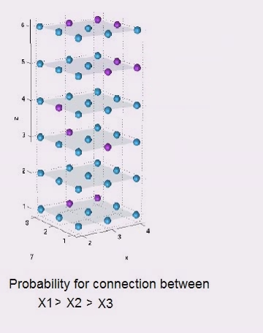
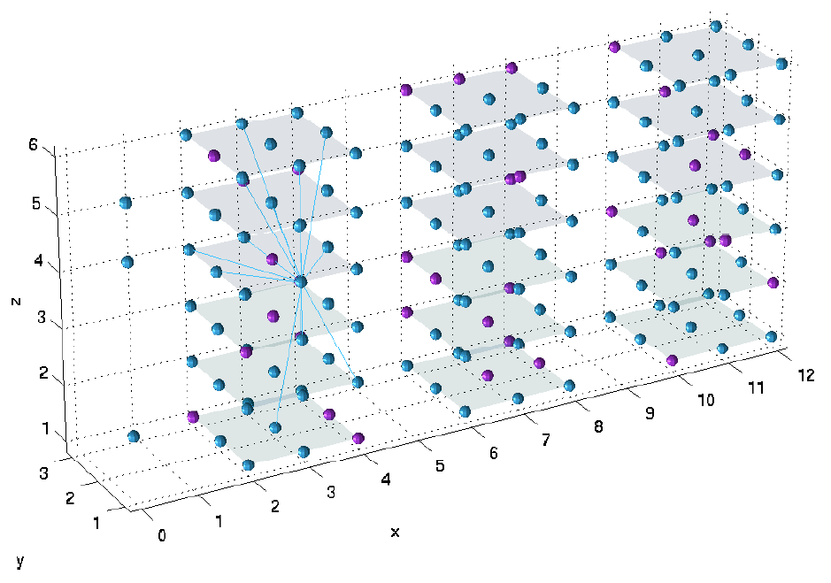
Topologies
Maass et al Architectures
Assume some Architectural structure.
Neuron have more chances to be connected to its close neighbors rather to far neurons

Slide 17
How does Liquid State Machine work? (Generalization)
Normal Behavioral of LSM
LSM
A
LSM A
LSM B
0101101101011100100101001010110111011000100
0101101101011101100101001010110111011000100
LSM
B

Slide 18
How does it work with damage in the liquid?
LSM Behavioral with damage
LSM
A
LSM A
LSM B
0101101101011101100101001010110111011000100
0101101101011101100101001010110111011000100
LSM
B

Slide 19
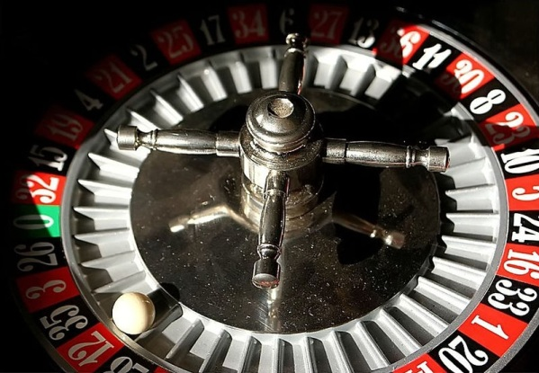
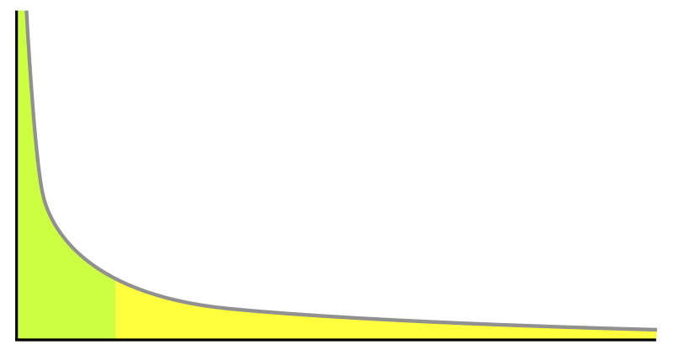
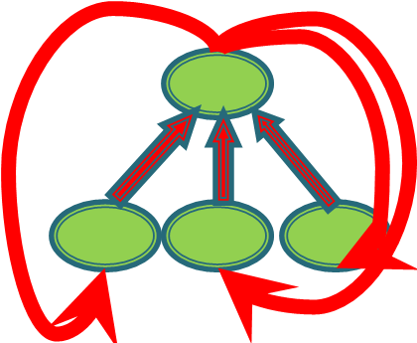
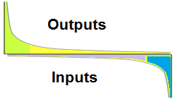
Liquid / Network Architectures
Maass et al
Random
Small World, Power Law
Feed Forward with Hubs
Small World, Power Law Two ways

Slide 20
Recognition Results - Summary
Noise
Dead Neurons
Architecture | 0.1% | 0.5% | 1% | 5% | 10%
Random | 87% | 67% | 61% | 54% | 52%
Hubs Topology | 97% | 91% | 86% | 70% | 62%
Maass et al | 79% | 60% | 55% | 51% | 49%
Power Law | 79% | 58% | 53% | 50% | 51%
Two Ways Power Law | 99% | 93% | 88% | 72% | 64%
0.1% | 0.5% | 1% | 5% | 10%
63% | 55% | 52% | 50% | 50%
95% | 88% | 85% | 76% | 67%
61% | 53% | 49% | 49% | 50%
55% | 51% | 51% | 50% | 51%
95% | 87% | 83% | 74% | 69%
Noise and Dead Neurons
Generalization Test
Architecture | 0.1% | 0.5% | 1% | 5% | 10%
Random | 68% | 57% | 52% | 50% | 49%
Hubs Topology | 96% | 89% | 86% | 75% | 68%
Maass et al | 64% | 55% | 52% | 51% | 52%
Power Law | 58% | 51% | 50% | 48% | 50%
Two Ways Power Law | 97% | 89% | 84% | 70% | 66%
0.1% | 0.5% | 1% | 5% | 10%
98% | 97% | 95% | 89% | 86%
100% | 97% | 97% | 96% | 95%
100% | 96% | 93% | 84% | 85%
100% | 97% | 93% | 90% | 89%
99% | 99% | 98% | 97% | 97%

Slide 21
Summary of Test 1
The “standard” LSM framework turns out not to be robust to damage in the liquid itself and hence not a good model of biological function.
However, choosing appropriate architectures can maintain the generalizability for spatio-temporal patterns and yet be robust.
Some of these architectures (e.g. small world) do seem to be biologically plausible.

Slide 22
Test 2
Categories
2
1
Wait & ID
ID On The Fly
What will happen if we give a stimuli, wait a while, then try to identify the pattern?

Slide 23
Difficult Case: Non – Cyclic input
Topology | Recognition Ability with noisy neurons |  |  |  |  | Generalization Recognition Ability Versus Topology
 | Noise Damage |  |  |  |  | Variability / Differences
 | 1% | 3% | 5% | 7% | 10% | 1% | 3% | 5% | 7% | 10%
Random | 0.53 | 0.54 | 0.53 | 0.50 | 0.51 | 0.70 | 0.58 | 0.57 | 0.58 | 0.61
Hubs Topology | 0.51 | 0.52 | 0.51 | 0.50 | 0.50 | 0.79 | 0.72 | 0.68 | 0.70 | 0.71
Maass | 0.51 | 0.51 | 0.53 | 0.52 | 0.52 | 0.74 | 0.63 | 0.61 | 0.62 | 0.63
Small worlds | 0.51 | 0.53 | 0.51 | 0.51 | 0.52 | 0.72 | 0.60 | 0.61 | 0.61 | 0.62
Why?

Slide 24
What Happen After The Signal Ends?
Normal Behavioral of LSM
LSM
A
LSM A
LSM B
0101101101011100100101001010110111011000100
0101101101011101100101001010110111011000100
Original path without damage
Desired activity with Damage in LSM
LSM
B
Current activity with damage in LSM

Slide 25
Possible solutions
Try to use biological rules that were found in real networks of biological neurons.
For example:
  Adapt the weights between the neurons.
  Sliding Threshold.
  Hebbian theory - Cells that fire together, wire together." (Carla Shatz, Stanford University)

Slide 26
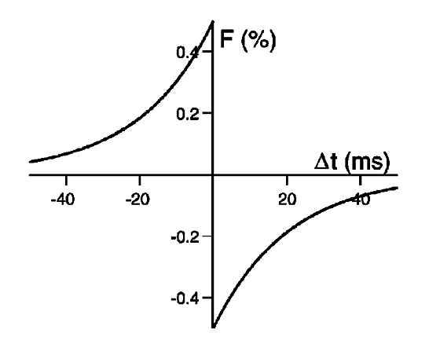
STDP (Spike-Timing-Dependent Plasticity)
Neuron A
Spikes
Time
Pre Synaptic
Post Synaptic
Neuron B
Time
If Neuron B fires as a result from Neuron A firing → the connection get stronger
If Neuron A fires after Neuron B fired
→ connection between them get weaker.

Slide 27
Sliding Threshold
When a Neuron fires more than 60% of its maximum frequency the threshold rises, therefore making it harder for the neuron to fire.
When a Neuron doesn’t fire for a relatively long period of time, the threshold becomes lower, therefore making it easier to fire.
Thus, e.g., some neurons fire spontaneously when they were quiet for a long period of time.

Slide 28
New Learning Procedure
Reset the network.
Run the network with the input and change the weights and the threshold according to the given input.
save the weights.
Running
Run the network with the input, starting with the weights discovered in the learning procedure. Continue to change the weights according to the input and the internal feedback.
After completing the processing, reset the weights and the threshold to the initial (after learning) state.

Slide 29
Difficult Case: Non – Cyclic input
Topology | Recognition Ability with noisy neurons |  |  |  |  | Generalization Recognition Ability Versus Topology
 | Noise Damage |  |  |  |  | Variability / Differences
 | 1% | 3% | 5% | 7% | 10% | 1% | 3% | 5% | 7% | 10%
Random | 0.53 | 0.54 | 0.53 | 0.50 | 0.51 | 0.70 | 0.58 | 0.57 | 0.58 | 0.61
Hubs Topology | 0.51 | 0.52 | 0.51 | 0.50 | 0.50 | 0.79 | 0.72 | 0.68 | 0.70 | 0.71
Maass | 0.51 | 0.51 | 0.53 | 0.52 | 0.52 | 0.74 | 0.63 | 0.61 | 0.62 | 0.63
Small worlds | 0.51 | 0.53 | 0.51 | 0.51 | 0.52 | 0.72 | 0.60 | 0.61 | 0.61 | 0.62
STDP + sliding threshold
Topology | Recognition Ability with noisy neurons |  |  |  |  | Generalization Recognition Ability Versus Topology
 | Noise Damage |  |  |  |  | Variability / Differences
 | 1% | 3% | 5% | 7% | 10% | 1% | 3% | 5% | 7% | 10%
Random | 0.80 | 0.74 | 0.72 | 0.69 | 0.66 | 0.92 | 0.87 | 0.84 | 0.85 | 0.86
Hubs Topology | 0.87 | 0.76 | 0.72 | 0.66 | 0.64 | 0.94 | 0.89 | 0.89 | 0.89 | 0.88
Maass | 0.83 | 0.74 | 0.72 | 0.70 | 0.66 | 0.92 | 0.86 | 0.86 | 0.84 | 0.85
Small worlds | 0.82 | 0.74 | 0.71 | 0.68 | 0.65 | 0.93 | 0.87 | 0.85 | 0.80 | 0.82

Slide 30
Summary Test 2
Liquid State Machine framework can benefit from “liquid” that is built like Feed Forward Hubs and Two-Way power law.
In addition to Topology, adding STDP and Sliding Thresholds can benefit the LSM
  It allows the LSM to be robust to noise even in non-cyclic inputs
  We hypothesize that this is producing an “effective” topology like the power-law. Current work.
The benefits are:
  Richness of activity patterns
  Good for spatio-temporal patterns
  Stability to noisy or damaged units.
  Somewhat more realistic model in terms of biology

Slide 31
Possible Tests
Tests
Categories
Function Approximation
Function fitting – fMRI blood-oxygen-level-dependent (BOLD) activity

Slide 32
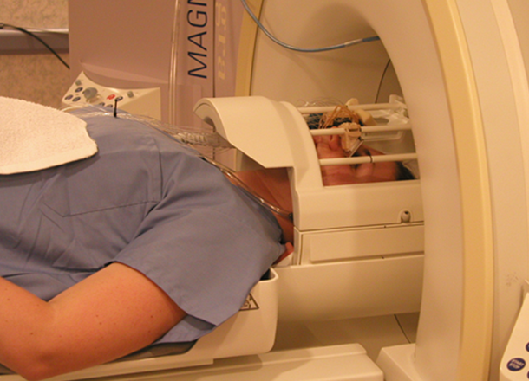


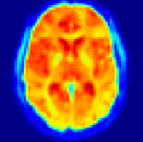
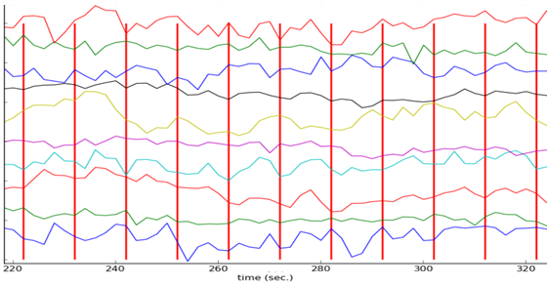
fMRI – functional Magnetic Resonance Imaging
fMRI Machine
A sequence of stimuli
Registered brain activity
(over time)
…
time
Blood Oxygen Level-Dependent (BOLD) signal (oxygen hemodynamic response) is a measurement of the brain activity
BOLD signal is recorded for each voxel inside the brain image
BOLD
v₁(t) Voxel 1
v₂(t) Voxel 2
.
.
.
v_{N}(t) Voxel N

Slide 33
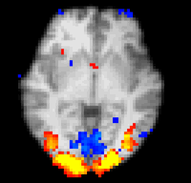
Analysis of fMRI Data – Brain Mapping
Highlighting areas of brain maximally relevant for a given cognitive or perceptual task
Brain Map
BOLD
v₁(t) Voxel 1
v₂(t) Voxel 2
.
.
.
v_{N}(t) Voxel N
Relevant voxels are highlighted

Slide 34
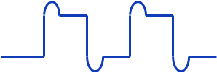
Brain Mapping – GLM Method
Brain Map
Generalized linear model
Predicted BOLD
Compare
Original BOLD
Relevant
voxels
Good prediction accuracy indicates the relevance of the voxel for a given perceptual/cognitive task

Slide 35
GLM Approach Drawbacks
Prior assumption is made on the expected ideal BOLD hemodynamic response
      The ideal BOLD hemodynamics may vary for different reasons
May lead to incorrect brain maps!!!
Expected Response
⊗
Real Responses

Slide 36

GLM (General Linear Model) Method
⊗
Predicted BOLD
signal
Stimuli
sequence
Expected
ideal
BOLD
Predictor
Convolved
stimuli
sequence
⊗
GLM
BOLD signal is reconstructed as a linear combination of input stimuli convolved with the expected ideal BOLD hemodynamic function (obtained theoretically).

Slide 37
The Schema
?
Testing data set
Predicted BOLD
B
A
A
B
B
predict
Brain Map
Predictor
Compare
Relevant
voxels
Original BOLD
A Reservoir predictor is trained to produce the BOLD voxel-wise given the sequence of stimuli based on a real data
Good prediction accuracy indicates the relevance of the voxel for a given perceptual/cognitive task

Slide 38
Results
Synthetic Datasets
Correlation between real and generated BOLD signals (Block design)
Noise Level (σ) | 0.1 | 0.2 | 0.3 | 0.4
Relevant Voxels | .813 | .535 | .426 | .383
Irrelevant Voxels | .097 | .083 | .035 | .095
Relevant voxel
Real Datasets
Block
LSM
Real
Predicted
 | Correlation
 | Block | ER | FER
Relevant Voxels | .835 | .354 | .193
Irrelevant Voxels | .070 | .067 | .055
Real
Irrelevant voxel
Block
Predicted
Real

Slide 39



Special Thanks to
Professor Larry Manevitz.

Slide 40
Thanks

Slide 41
Backup slides

Slide 42
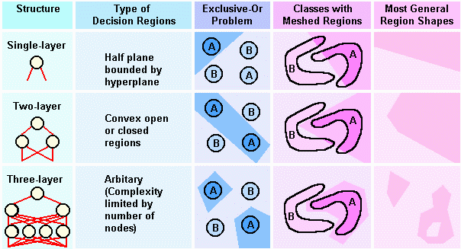
Pattern Separation of NN architecture

Slide 43

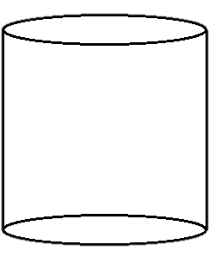
The Liquid Solution for Time
Read Out
2
1
Input
3
Liquid
Traditional Detector

Slide 44
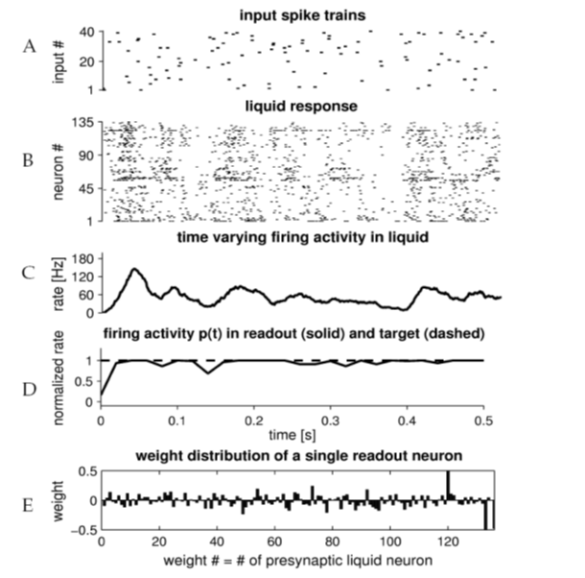
Readout-Assigned Equivalent States of a Dynamical System
Notes:
The test input consists of 40 Poisson spike trains, each with a constant rate of 5 Hz.
(B) Raster plot of the 135 liquid neurons in response to this input. Note the large variety of liquid states that arise during this time period.
(C) Population rate of the liquid (bin size 20 ms). Note that this population rate changes quite a bit over time.
(D) Readout response (solid line) and target response (dashed line). The target response had a constant value of 1 for this input. The output of the trained readout module is also almost constant for this test example (except for the beginning), although its input, the liquid states of the recurrent circuit, varied quit a bit during this time period.
(E) Weight distribution of a single readout neuron. ????

Slide 45
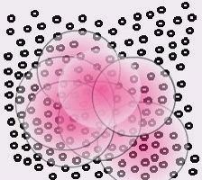
Why Maass et all Architecture not working?

Slide 46
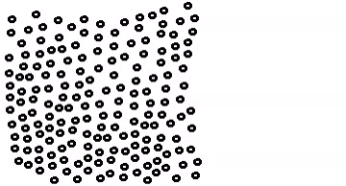
Why Small World or Feed Forward with Hubs works?
When there is an interference in the Liquid its contain in its world and have less affects on other worlds
Each hub in every network will act as a filter or compressor for information flow between groups.

Slide 47
Demo

Slide 48

Demo
Which representation matches its music?
1
2
3
Back

Slide 49

Demo
Which representation matches its music?
1
2
3
Back

Slide 50
Demo
Which representation matches its music?
1
2
3
Back

Slide 51
Topologies

Slide 52

Uniform Random Liquid
Connect random neuron to another neuron that chosen randomly
There is no assumption on the distances between neurons.

Slide 53
Uniform Random Liquid - Results
Topologies
Noise Generator
Dead Neurons
Failed
Generalization Test
Combine Test
Topologies

Slide 54
Maass et al Architectures
Assume some Architectural structure.
Neuron have more chances to be connected to its close neighbors rather to far neurons

Slide 55
Maass et al Architectures
Topologies
Noise Generator
Dead Neurons
Failed
Generalization Test
Combine Test
Topologies

Slide 56
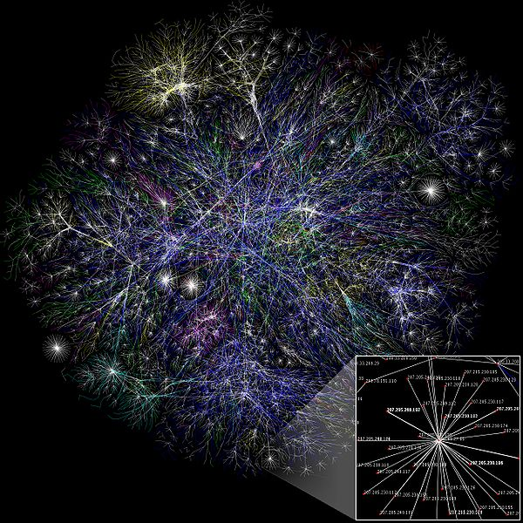
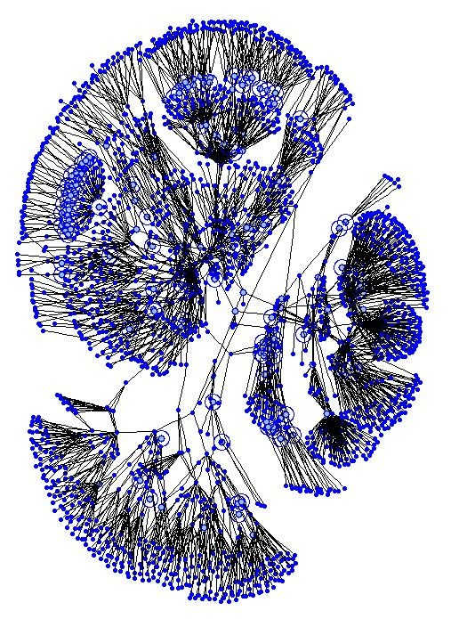
Small worlds, Power law
Connection between neurons will base on the amount of degree that the neuron have.
From 'The Opte Project'

Slide 57
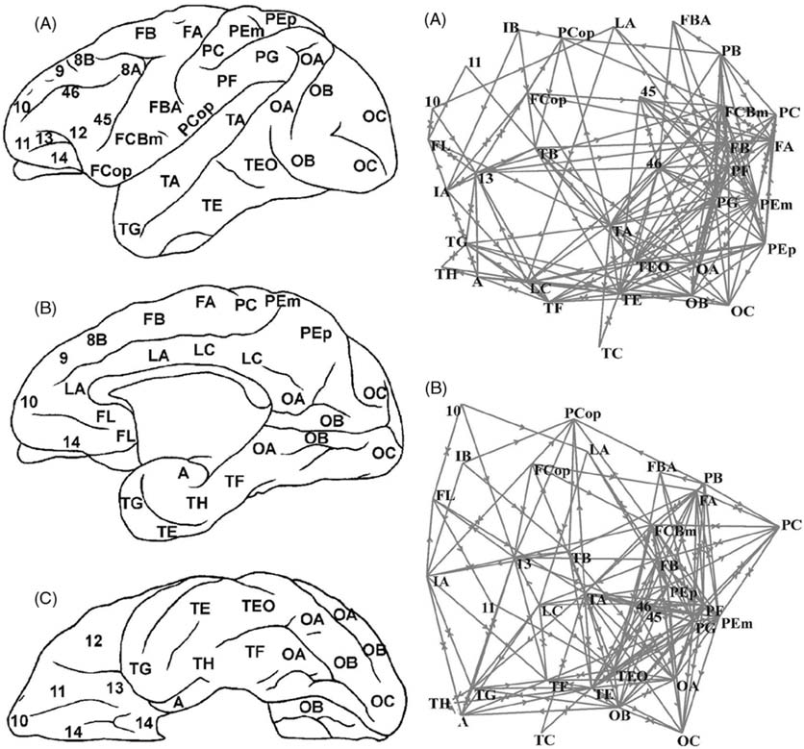
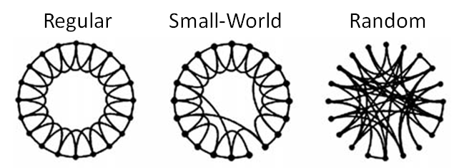
Small Worlds
Small-world diagram
(Watts and Strogatz 1998)
Cortical connectivity maps
(Stephan et al.,2000)

Slide 58
Small World, Power Law
Noise Generator
Dead Neurons
Failed
Generalization Test
Combine Test

Slide 59
Why is it not working?
Distribution of connection?

Slide 60
Small worlds, Power law – Connectivity Distribution
Here is the connection distribution

Slide 61
Uniform Random Liquid - connection distribution
Here is the connection distribution

Slide 62
Topologies
Maass et al Architectures - connection distribution
Here is the connection distribution
Topologies

Slide 63
Feed Forward Hubs Network Architectures
What about hubs?

Slide 64
FF Hubs Network Architectures
3 to 6 Neurons per group
3 to 6 Neurons per group
1/3 will be Hubs
3 to 6 Neurons per group
3 to 6 Neurons per group
3 to 6 Neurons per group
3 to 6 Neurons per group
3 to 6 Neurons per group
3 to 6 Neurons per group
3 to 6 Neurons per group
3 to 6 Neurons per group
243 Neurons

Slide 65
FF Hubs Network Architectures
3 to 6 Neurons per group
3 to 6 Neurons per group
3 to 6 Neurons per group
3 to 6 Neurons per group
3 to 6 Neurons per group
3 to 6 Neurons per group
3 to 6 Neurons per group
3 to 6 Neurons per group

Slide 66
FF Hubs Network Architectures - Connection Distribution
Here is the connection distribution

Slide 67
FF Hubs Network Architectures - Results
Topologies
Noise
Dead Neurons
Pass
Generalization Test
Combine Test
Topologies

Slide 68
Double Power Law
Outputs and the Inputs of the neurons that have been chosen before will have more chance to be chosen again.

Slide 69
Double Power Law - connection distribution
Here is the connection distribution

Slide 70
Double Power Law - Results
Topologies
Noise Generator
Dead Neurons
Pass
Generalization Test
Combine Test
Topologies

